Slide 1
Impact of quarterly earnings on stock price
PRESENTED BY Lyzz Ma, Nina Han, Yuanbo Zhang, Yuhang Fan, Zhaohui Wu
05/10/2022
Notes:
Today our team 2 will talk about the impact of quarterly earnings on stock prices

Slide 2
Introduction
Research Topic
Interested in how earnings report drive stocks prices
Use earning surprise to measure the difference in expectation between the analyst’s estimated EPS and the reported EPS.
Project description
C++ based console application
Fetches Russell 3000 stocks data from EOD, and put them into 3 groups based on surprise%.
Calculates financial metrics for each group
Visualizes calculation results with Gnuplot
Notes:
Specifically, we are interested in how earnings report drive stocks prices before and after the announcement date. We use earning surprise to measure the difference between company’s reported profits and analysts’ estimate. So, for example ,A “+” positive surprise means that the reported value is above investors or analyst’s expectation. In terms of our project, we firstly, fetches Russell 3000 stocks data from EOD, and put them into 3 groups based on percentage of surprise. We then calculates the financial metrics and visualizes using Gnuplot.

Slide 3
Task Allocation
Name | Task
Zhaohui | Introduction, Flow Chart, Gnuplot, Conclusion
Lyzz | Multi-Thread & Optimization, Counter & Timer
Yuanbo | UML, Market, Indep. Function, TimeSeries
Yuhang | Date, Stock, Benchmark
Nina | Math, Indep. Function, Matrix
Notes:
Introduction
Flow Chart - Main Menu
UML - Data Structure
Individual Class Introduction:
Market → independent functions → Stock → TimeSeries → Date → Math → independent functions → Matrix → Counter & Timer
Multi-Thread
Visualization
Conclusion

Slide 4
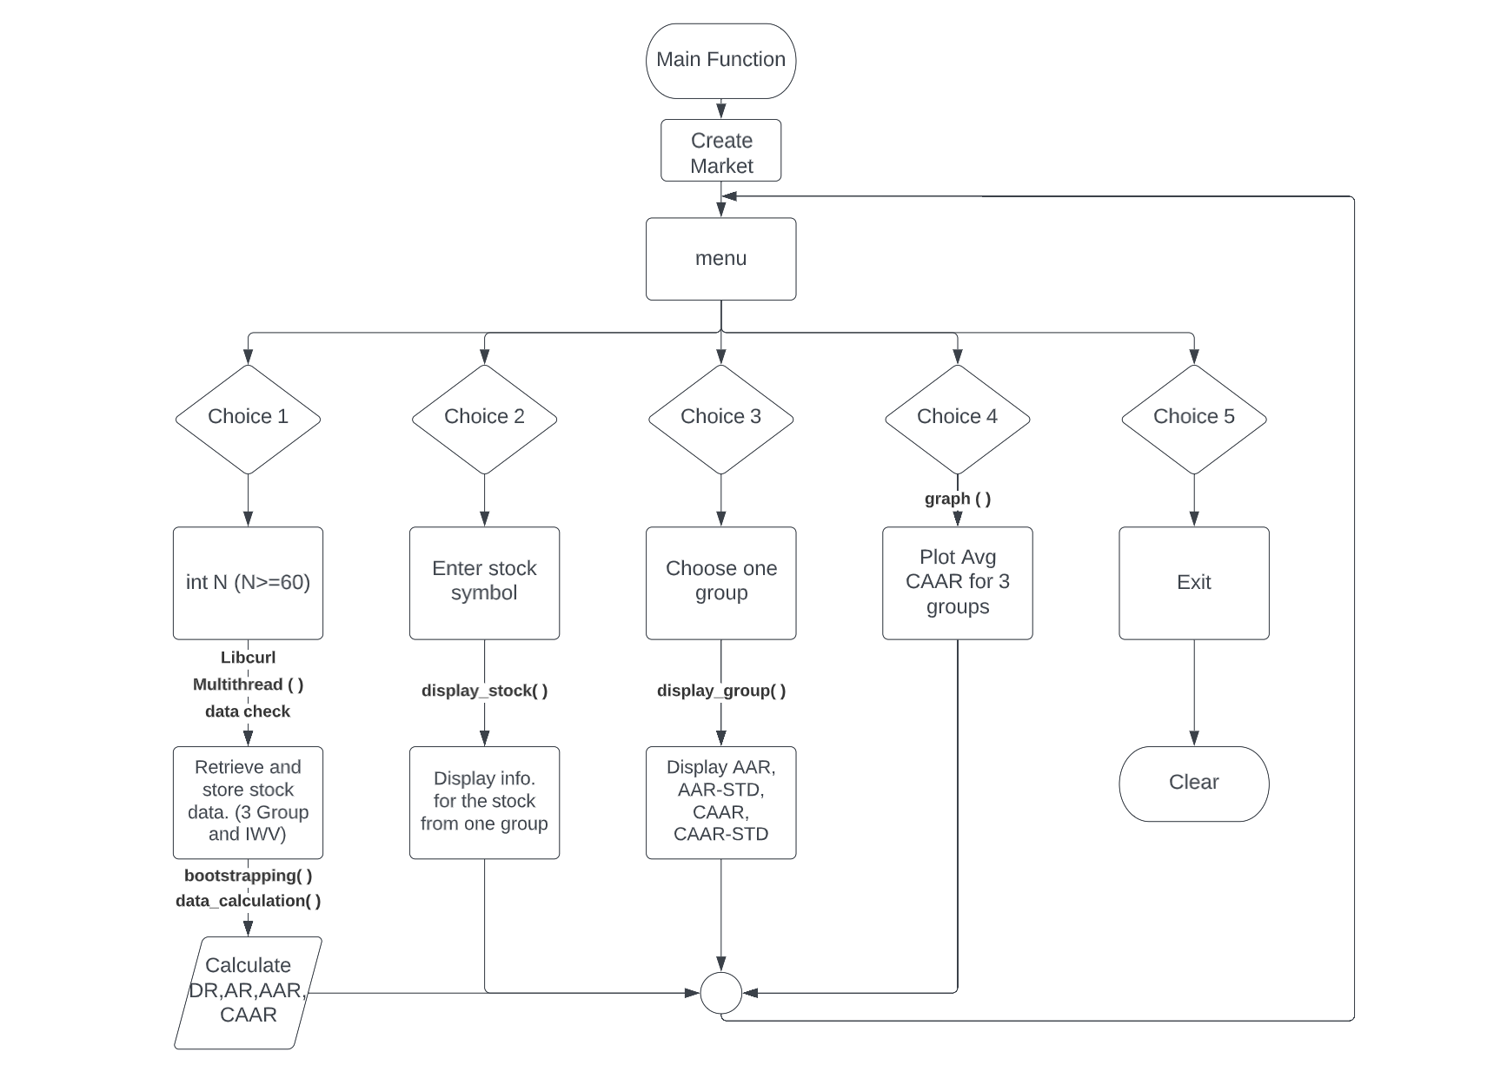
Flow Chart
Notes:
Moving on to the flow chart of our program. We start with the main function, create object market. Then there are five options in our menu. We have to enter N first, before running other choices. Use lib curl, multi thread to get data from EOD and check the data and finally do the calculation including Daily return, AR, AAR, and CAAR. After that, we have choice 2 for specific stock, choice 3 to display info for one of the three group, choice 4 for plot and visualization. And enter 5 to exit the program. Next, Yuanbo will explain our UML diagram.

Slide 5
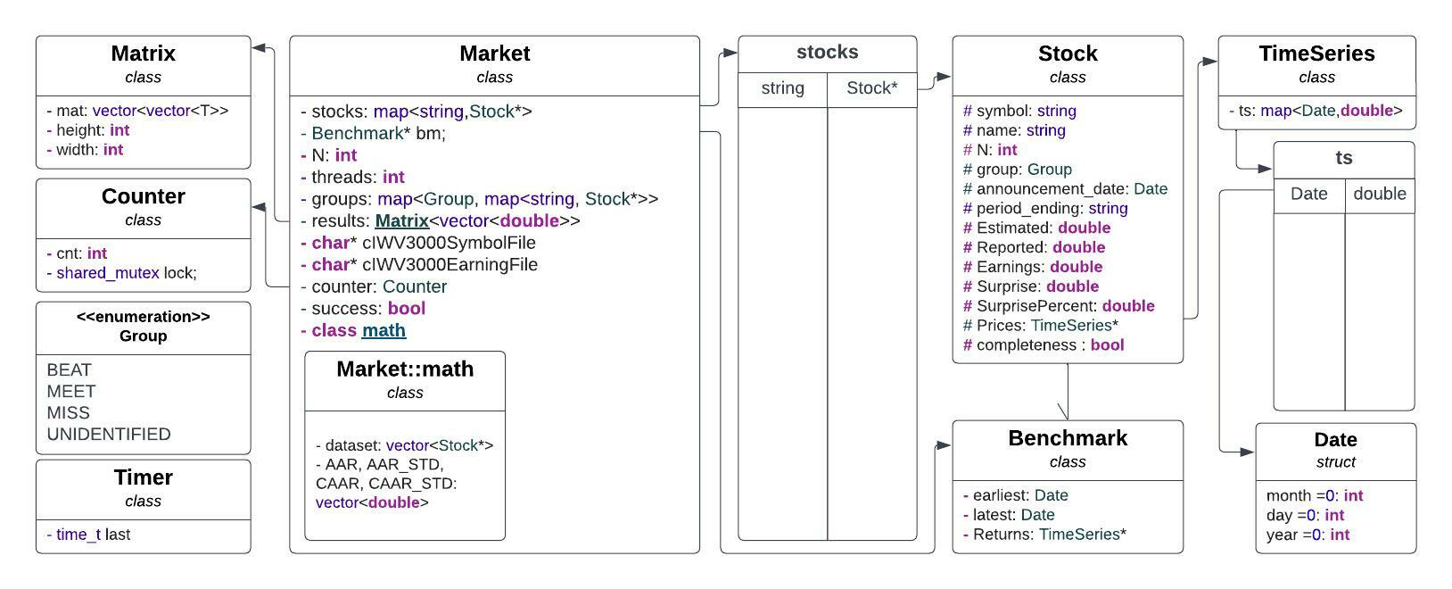
UML - Data Structure
Notes:
Lyzz
We start from the market, the base environment for our program.

Slide 6
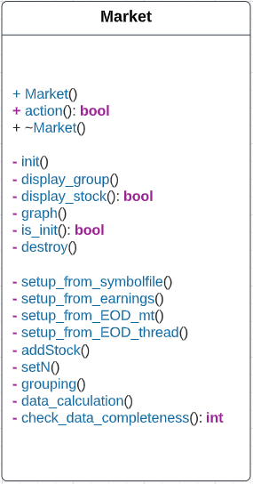
Market
Base Environment
Access to the menu
Set up stocks with csv files
Store stocks using pointers
Sort and group stocks
Set up the environment for calculation
Constructor
Menu
Destructor (Free memory of DA)
Initialize
Display results of groups (Menu 3)
Display result of one stock (Menu 2)
Graph with gnuplot (Menu 4)
Check whether the market is created
Clear memory in case of
Read from symbol file
Read from earring file
Read from EOD with multi-thread
Set up the multi-thread task
Add stock by creating pointers
Set N for the market
Sort and group qualified stocks
Invoke math calculation
Check completeness

Slide 7
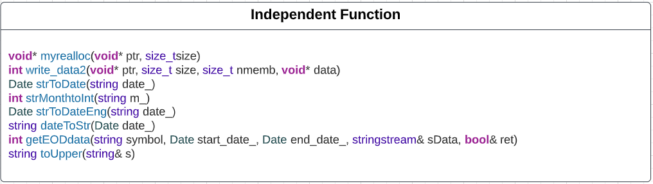
Independent Functions
Convert strings into Date
Catch data from EOD (lcurl)

Slide 8
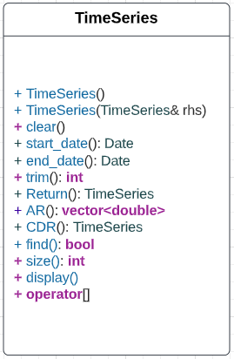
TimeSeries
Data Structure
Store the value using map<Date, double>
Calculate abnormal returns
Calculate cumulative returns
Constructor
Constructor (Copy)
Clear the existing map
Return the first date stored in the map
Return the last date stored in the map
Trim the TimeSeries to ensure the length
Create a TimeSeries of returns according to prices
Calculate AR using input benchmark
Calculate CDR according to prices
Check whether the date is in the map
Return the size of the map
Display dates and corresponding prices and CDRs
Operator to access a specific key

Slide 9
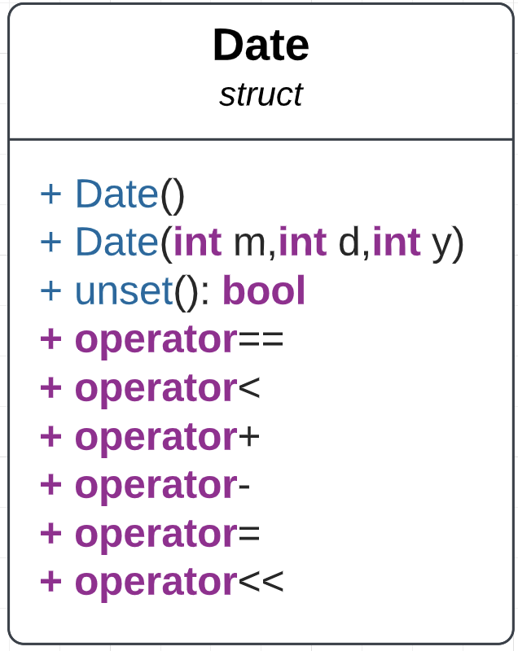
Date
Compare the order of the date.
(Used to decide the order when storing values in map ts in TimeSeries; used in benchmark update_period() )
Date Date::operator+(int days) const{
Date ret = *this;
ret.day += days;
int curr_leap = leap(ret.year) ? 1:0;
while(ret.day > mdays[curr_leap][ret.month-1]){
ret.day -= mdays[curr_leap][ret.month-1];
ret.month++;
ret.year+=(ret.month-1)/12;
ret.month = (ret.month-1)%12+1;
curr_leap = leap(ret.year);
}
return ret;
}

Slide 10
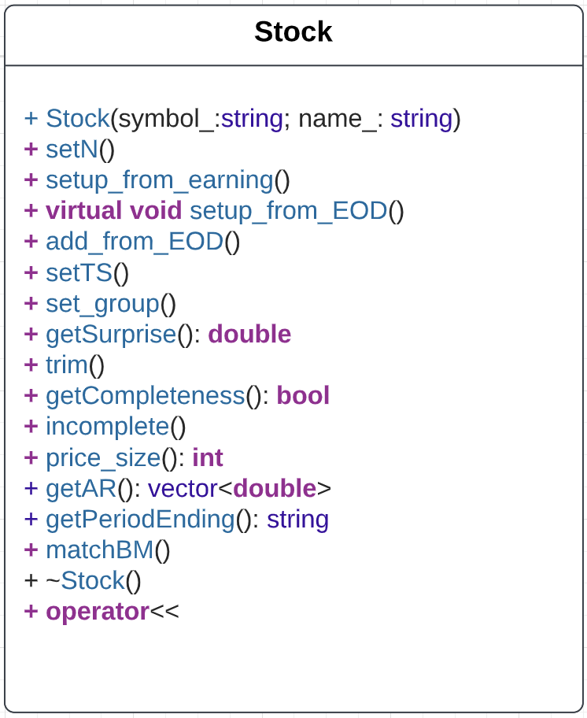
Stock
void Stock::setup_from_EOD(bool& ret){
if(!ret) return;
Timer t;
Date start_date_ = announcement_date-3*N/2;
Date end_date_ = announcement_date+3*N/2;
stringstream sData;
if(getCompleteness()){
getEODdata(symbol, start_date_, end_date_, sData, ret);
if(!ret) return;
setTS(sData);
}
if(!ret) return;
trim(ret);
if(!getCompleteness()){
delete Prices;
Prices = NULL;
}
}
Set N and reshape timeseries
Get data from earning file by Market class, and set up data in Stock class
Set up TimeSeries Price by calling function getEODdata() and setTS()

Slide 11
Stock
Trim the TimeSeries Price to make sure the length of it is (2*N+2)
Return a vector of abnormal return, whose length is 2*N+1
Check if announcement date of the Stock matches any date in Benchmark

Slide 12
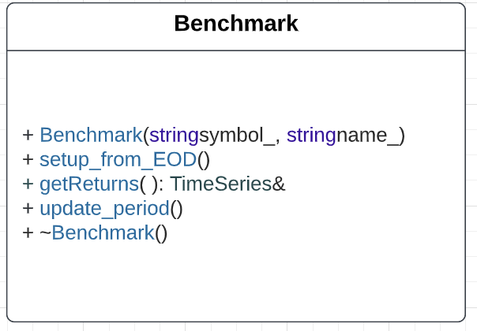
Benchmark
void Benchmark::setup_from_EOD(){
Date start_date_ = earliest-2*N;
Date end_date_ = latest+2*N;
stringstream sData;
getEODdata(symbol, start_date_, end_date_, sData);
setTS(sData);
Returns = new TimeSeries(Prices->Return());
}
Set up TimeSeries Return by first setting up Price and then calling Return() in class TimeSeries
Update earliest and latest to earliest date and latest date of all Stock announcement dates

Slide 13
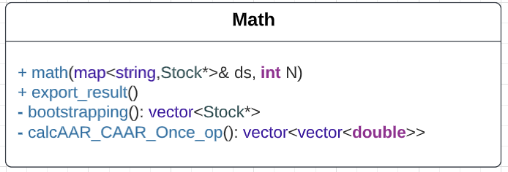
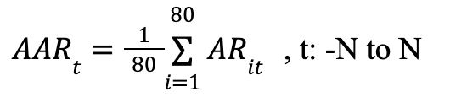
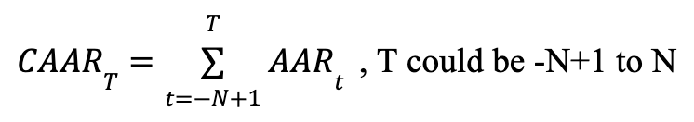
Math
// constructor with parameter
// bootstrap 40 times, do calculation, populate result matrix
// bootstrap one time to have 80 unique stock
// do calculation for one bootstrap

Slide 14
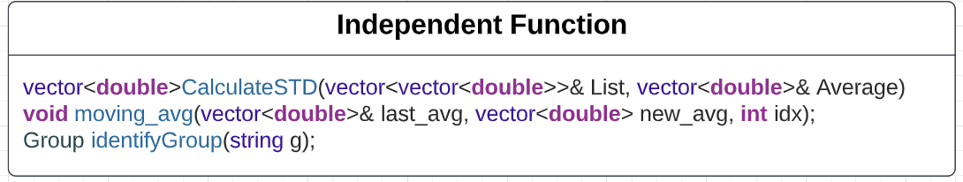
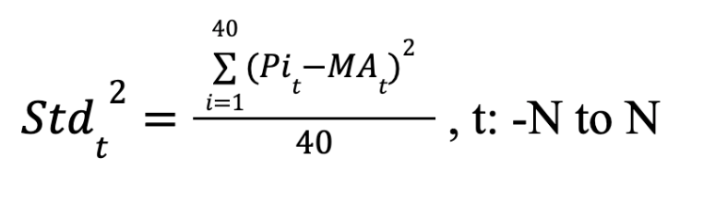
Independent Functions
// calculate Standard Deviation
// identify the group user enters
// calculate a rolling average

Slide 15
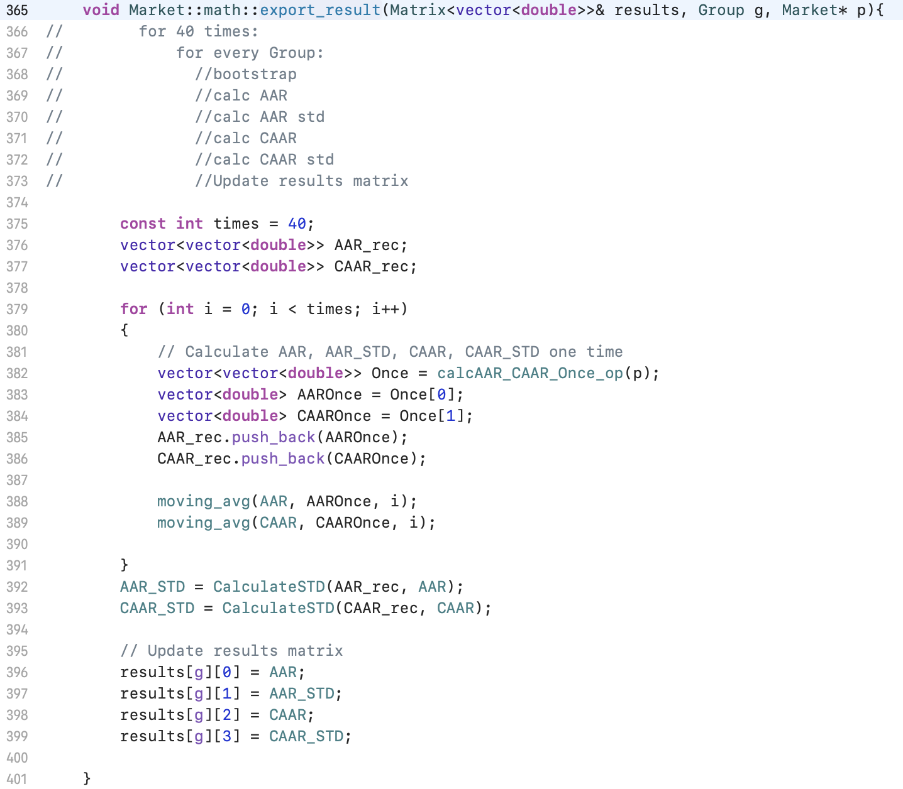
bootstrapping() & calc_AAR_CAAR_op()
called here
Call by reference

Slide 16
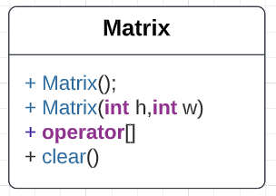
Matrix
// default constructor
// constructor with parameter
// overloaded operator []
// to clear everything in Matrix

Slide 17
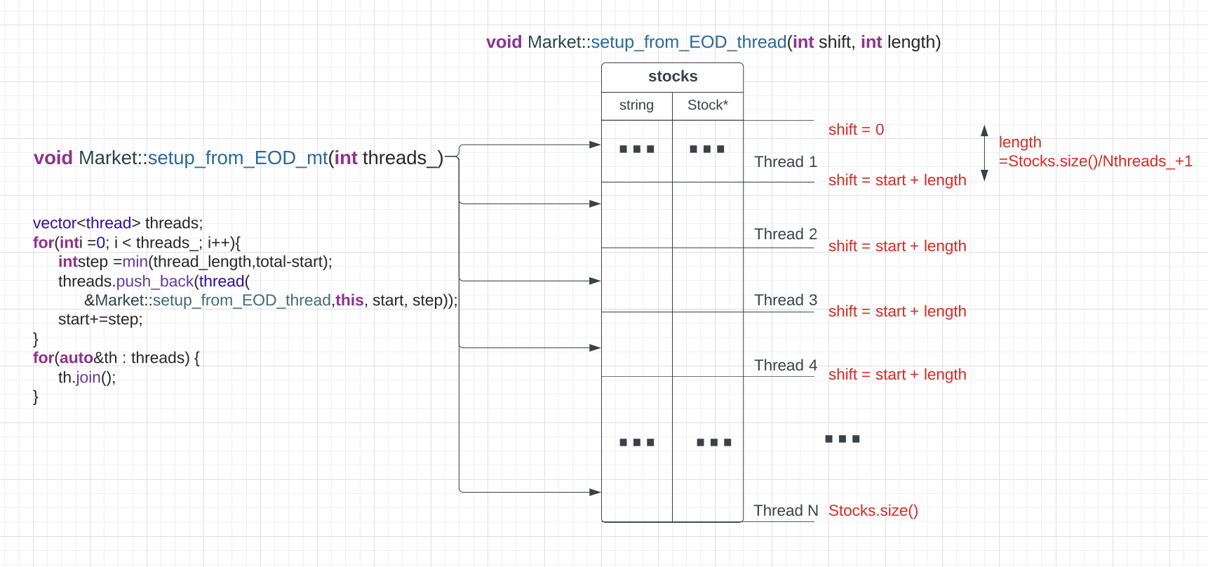
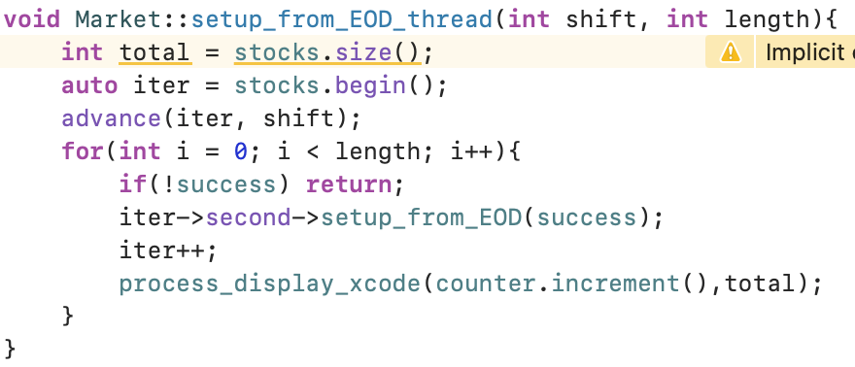
Multi Thread & Optimization
Notes:
After finishing all the basic functions of the project, we figured out that it spent too much time on catching data from EOD, so that’s where we managed to focus our optimizations on.
The one without multithread only process data catching for one stock per time which is so slow. So, the general idea of mt iis to separate the entire stocks map into several consecutive parts, and assign each part to a thread to run, so it’s able to allow several stocks catching their data at the same time.
And here’s the code. FIrst we want a manager-level function to invoke the actions of multithreads, which is our setup_from_EOD_mt function. In it, we construct several threads, and start them. For each thread, we want them to do a function called set_up_from_EOD_thread. ^ It’s parameters include a start or shift, representing the start position of the part, and a length or step, representing how many stocks it’is going to handle. Then in the function, the thread will get to and process for its relative part using iterator.

Slide 18
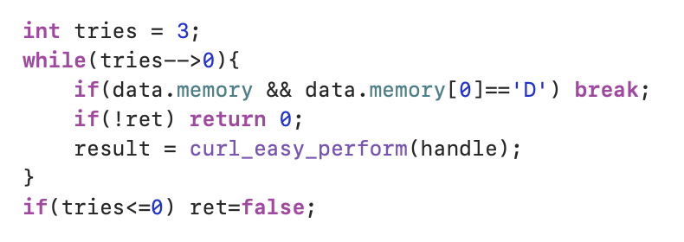
Multi Thread & Optimization
Problem: Too Many Requests -> Catch Wrong Data
Need to Solve:
Retry catching data
Notes:
However, multithreads brought up the problems of too many requests sending from threads, which will cause the program to catch wrong data shown as an error page or nothing, or even collapse. Here’s our solutions for such circumstances. First, we gave each stock three tries, which means that if a wrong data caught was figured out, it will try to re-catch until its correct. If it ran out of tries, it will stop, meaning that we failed to catch any data.

Slide 19
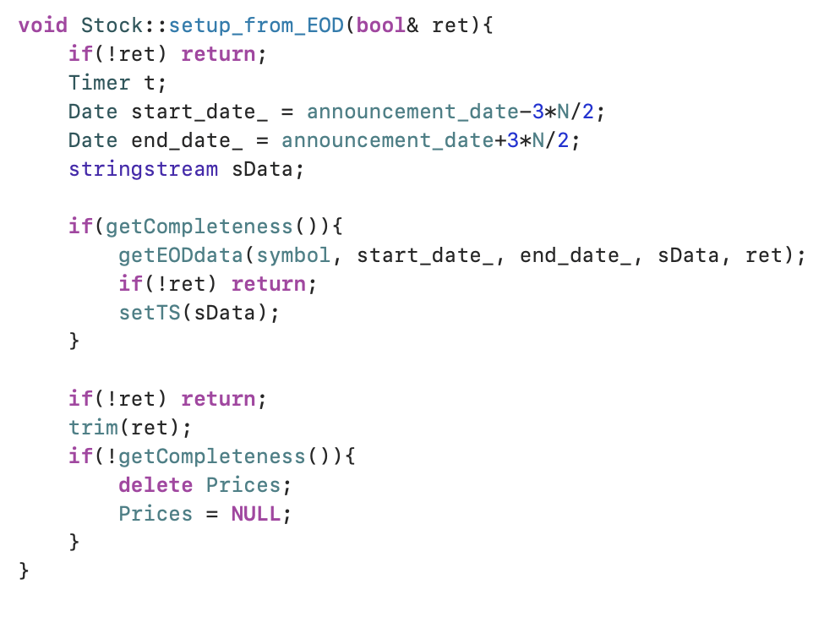
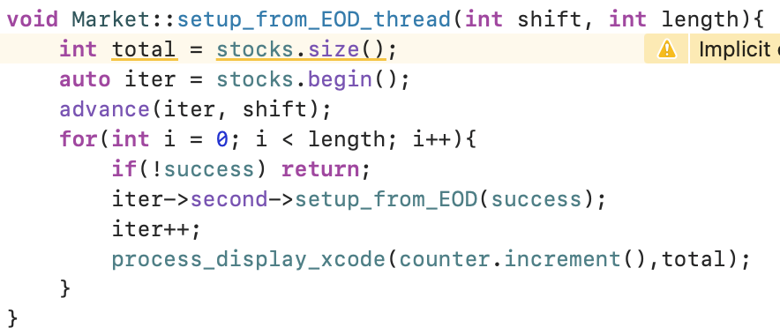
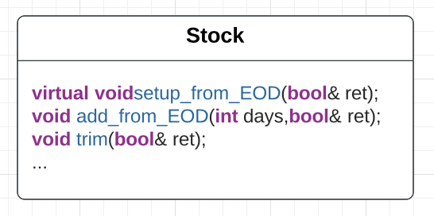
Multi Thread & Optimization
Problem: Too Many Requests -> Catch Wrong Data
Need to Solve:
Retry catching data
Continue failing: stop threads
Notify upper-level functions
Notify other threads
Notes:
Also, if one thread failed, we do not want the other threads to work any more. Thus, we want it to notify the upper-level functions as well as other threads that we want the entire process to stop. To achieve that, in many function that including the process of catching data from EOD, we add a boolean parameter passed by reference as a fail control. All return boolean shows here refer to a member variable in the market class called success, which can be read and written by all the threads. ^By doing so, if any of the threads fail and change the return object to false, all the other threads will know that when checking and stop their current process to avoid waste of time.

Slide 20
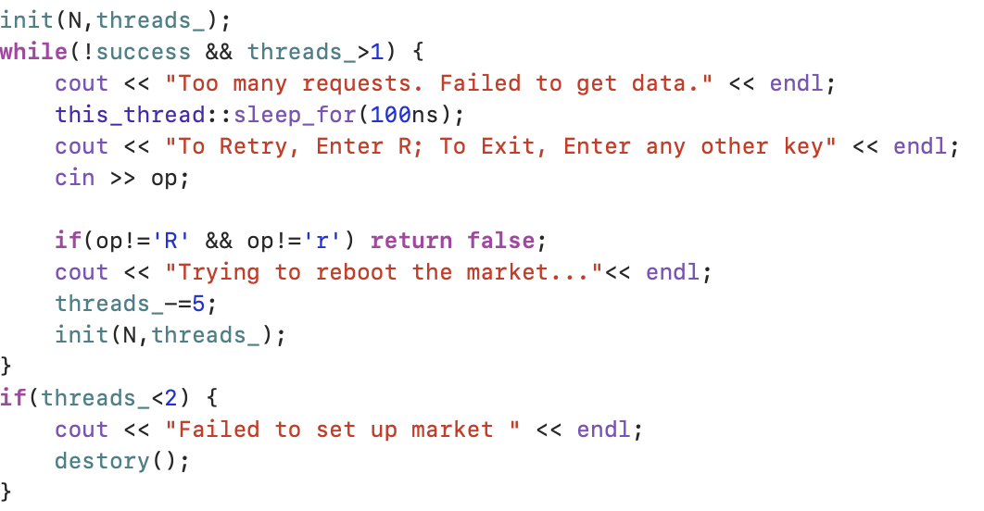
Multi Thread & Optimization
Problem: Too Many Requests -> Catch Wrong Data
Need to Solve:
Retry catching data
Continue failing: stop threads
Restart the process with fewer threads
In
Notes:
Finally, if the process fails, we will try to reboot the initialization process with smaller number of threads to avoid the “too many requests” issue. We will ask the user whether to retry and if so , we reduce the number of threads by five each time until 1.

Slide 21
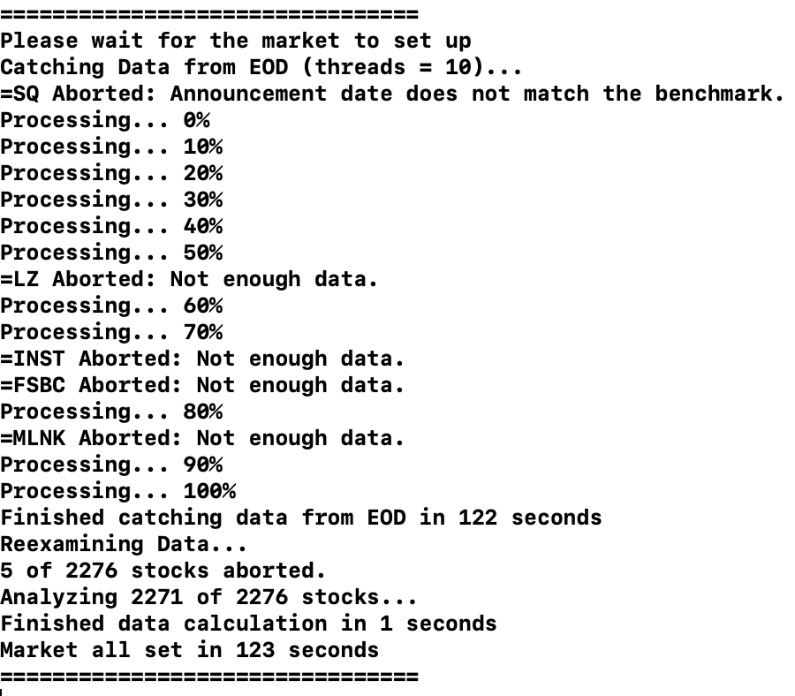
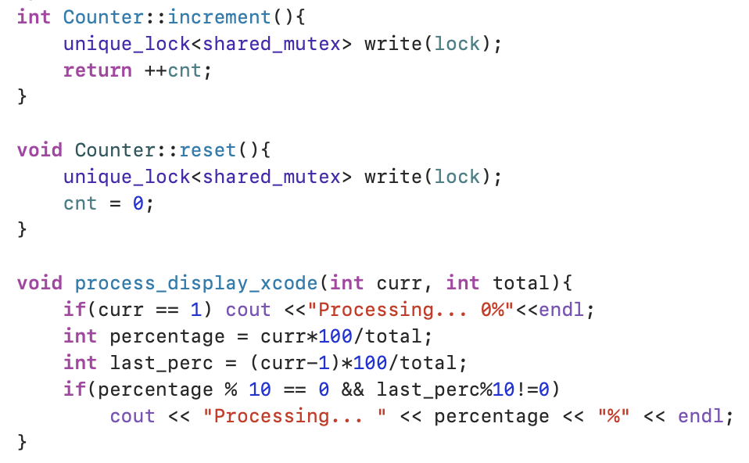
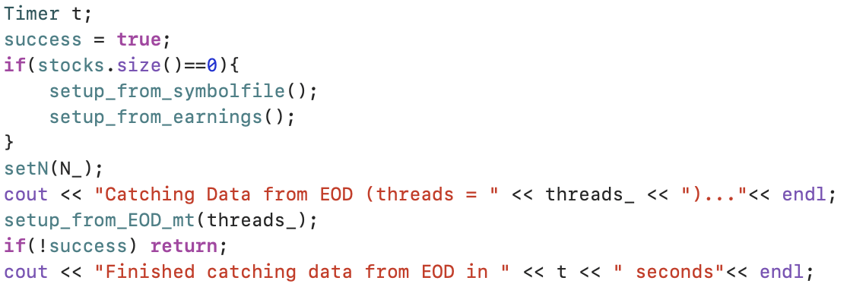
Counter & Timer
Notes:
We also added some other elements to keep track of the performance of the application of multi-threads. They are the counter and timer. On the slides show parts of our output. The display of processing percentage is achieved by the process_display function which will calculate the percentage of how many of the stocks finishing catching data and output the percentage when a new ten is achieved. The timer helps record the time of process so that we can directly see the performance.

Slide 22
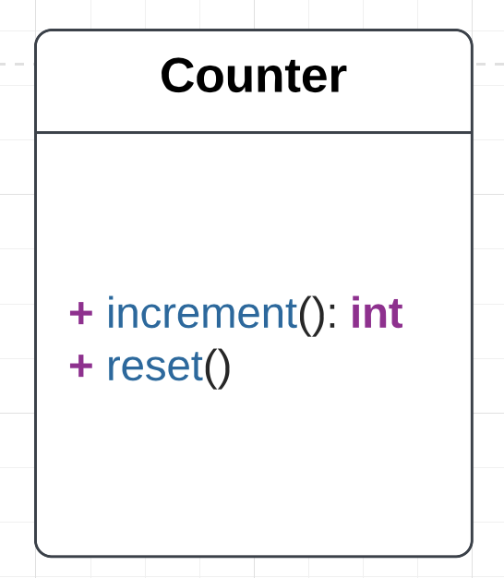

Counter
Notes:
To count how many stocks have been caught data, everytime one stock is finished setting up from EOD, we use a simple integer increment function to add one to a member of market named counter which is shared by all the threads. However, as this part is called by multi threads, we need to pay attention to synchronization controls among threads, which to add a lock.

Slide 23
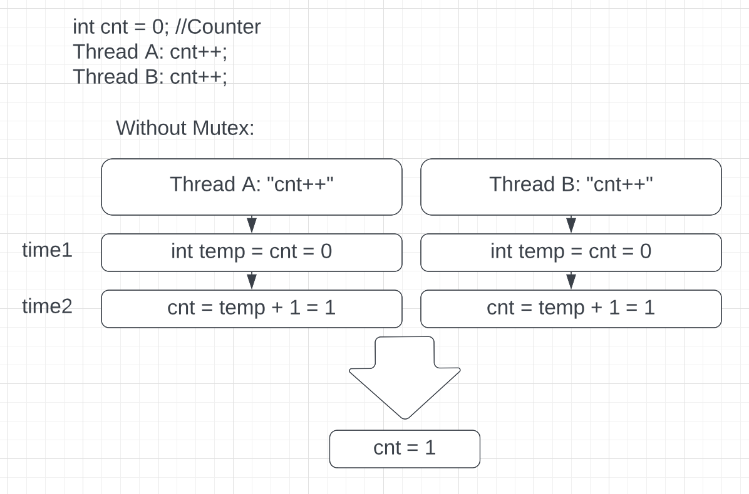
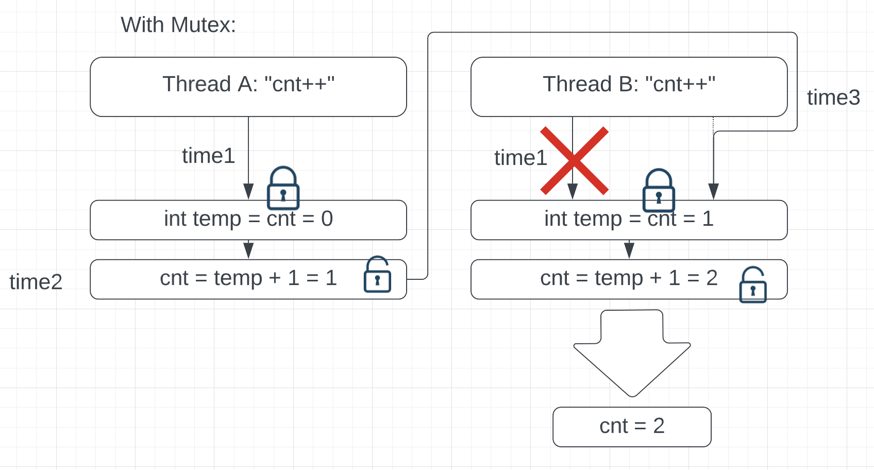
Counter
Notes:
Here’s what it means. If we have a counter integer and both threads wanna add one to it at the same time, the problem is that they will first get the counter’s original value, add one to it and update it. If the get value part is done almost at the same time, both threads will add one to the same zero value here, instead of doing increment one by one, so the output would finally be one, which is false. So, if we add a lock to the counter variable, that once thread A is getting and changing its value, we force thread B to wait until thread A is finished and unlock the variable. Thus, the increment process is forced to be done one by one, and the output will be the correctly 2.

Slide 24
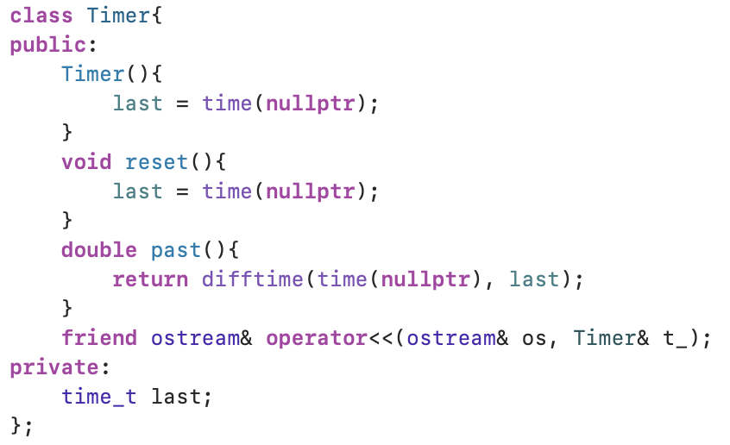
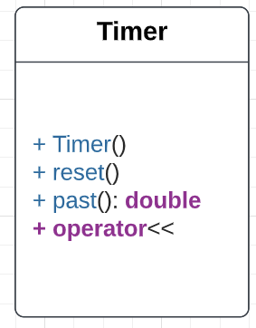
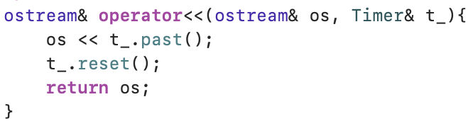
Timer
Instance:
Timer Entire;
Timer T;
….Code Block A….
cout<<T<<endl; //Time spent by A
….Code Block B….
cout<<T<<endl; //Time spent by B
cout<<Entire<<endl; //Time spent by A+B
Notes:
For the timer class, we apply the cpp build-in ctime library. When a timer object is constructed, it records the current time. Everytime it has been output, it displays the time difference between the current time and the recorded time “last”, and then reset last. Which means that every time it displays, it will show the length of time period from last time displayed or constructed to the present.

Slide 25
Gnuplot
void Market::graph(){
FILE *pipe, *tempDataFile1, *tempDataFile2, *tempDataFile3;
const char *tempDataFileName1, *tempDataFileName2, *tempDataFileName3;
double x,y;
int i;
tempDataFileName1 = "BEAT";
tempDataFileName2 = "MEET";
tempDataFileName3 = "MISS";
pipe = popen("/usr/local/bin/gnuplot --persist", "w");
if (pipe != NULL)
{
tempDataFile1 = fopen(tempDataFileName1,"w");
for (i=0; i < 2*N; i++)
{
x = i-N;
y = results[BEAT][2][i];//matrix:3*4; every cell:(2N+1)
fprintf(tempDataFile1, "%lf %lf\n", x,y);
}
fclose(tempDataFile1);
…
// Send it to gnuplot
fprintf(pipe,"plot \"%s\" with lines, \"%s\" with lines, \"%s\" with lines\n", tempDataFileName1, tempDataFileName2, tempDataFileName3);
fflush(pipe);
fprintf(pipe,"exit \n");
pclose(pipe);
// Clean up the temp file
remove(tempDataFileName1);
remove(tempDataFileName2);
remove(tempDataFileName3);
pclose(pipe);
Use pipe to connect with Gnuplot
“w”=write: Create an empty file
x: Date
y: calculated CAAR
Notes:
This is the code we use for plot. We need to use Pipe to connect our program with Gnuplot cuz, there are two different processes. Firstly create three temp files, assign the group name to each files. Then Open the pipe and connect to Gnuplot. In the for loop, X is the date, starting from -N to N. Y is the calculated CAAR. Finally, we clean up the temp file and close the pipe.

Slide 26
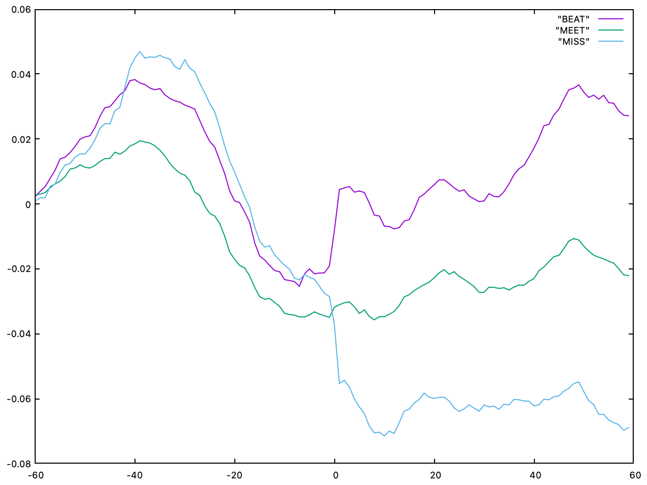
Visualization
Announcement Date
Notes:
As we can see in the graph, CAAR for group “BEAT” is the highest followed by “MEET” group and MISS group, which makes a lot of sense, since the reported profit for Beat group exceed analysts’ expectation, so the stock price goes up. Same logic apply to MEET and Miss group.

Slide 27
Conclusion
Stock prices are extremely sensitive close to the earning report announcement date.
The news and info. are not quickly digested by investors.
the CAAR for BEAT(MISS) groups still drift upward(downward) for a couple of weeks after announcement date.
Our results follow the Post-Earning announcement Effect/Drift (PEAD) effect, where the trend for a stock’s CAAR to move following the direction of earning surprise after the announcement date for several weeks(>60 days).
Notes:
So, finally, this is what we find for our research.
Stock prices are extremely sensitive close to the earning report announcement date.
The news and info. are not quickly digested by investors. Since the CAAR for BEAT group still drift upward, Miss group still drift downward after announcement date and this phenomenon last for a couple of days..
We called this effect Post-Earning announcement Effect/Drift (PEAD)::where the trend for a stock’s CAAR to move following the direction of earning surprise after the announcement date for several weeks(>60 days).

Slide 28
Reference
Post–earnings-announcement drift. Wikipedia. Retrieved May 7, 2022, from https://en.wikipedia.org/wiki/Post%E2%80%93earnings-announcement_drift

Slide 29
Thank you

